Slide 1
Hook into Office 365 APIs

Slide 2
Lab notes…

Slide 3
To keep things moving...
Perform Exercise 1 in lab 4
You're just preparing the environment

Slide 4
Agenda
Azure Active Directory
Discovery Service

Slide 5
Azure Active Directory

Slide 6
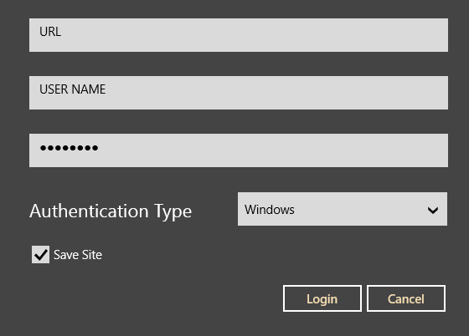
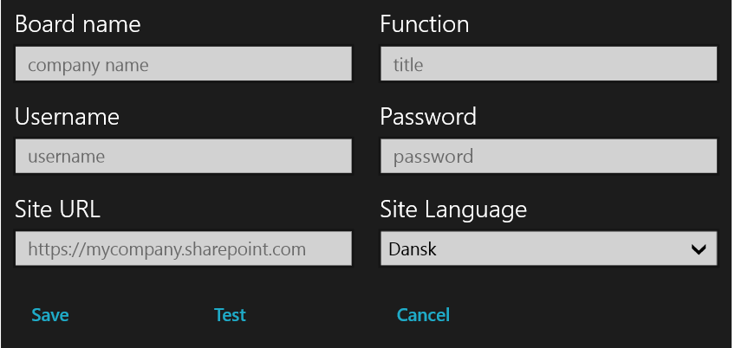
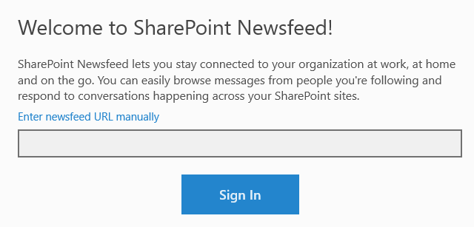
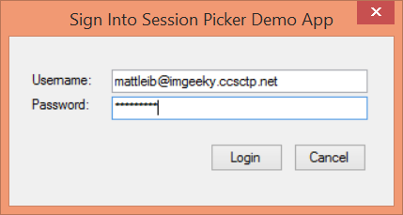
Office 365 Device Apps
Notes:
Prior to the release of the Office 365 APIs, device apps had to prompt users for credentials for the service, and in some cases the location of the resources.
Storing credentials is very risky, and a worst practice.

Slide 7
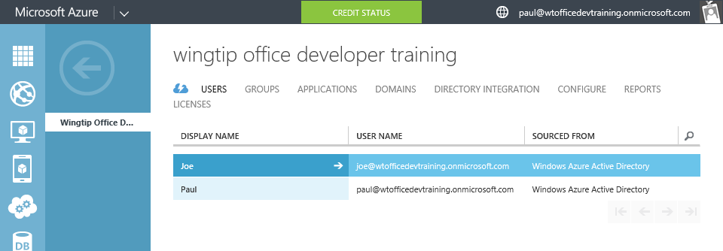
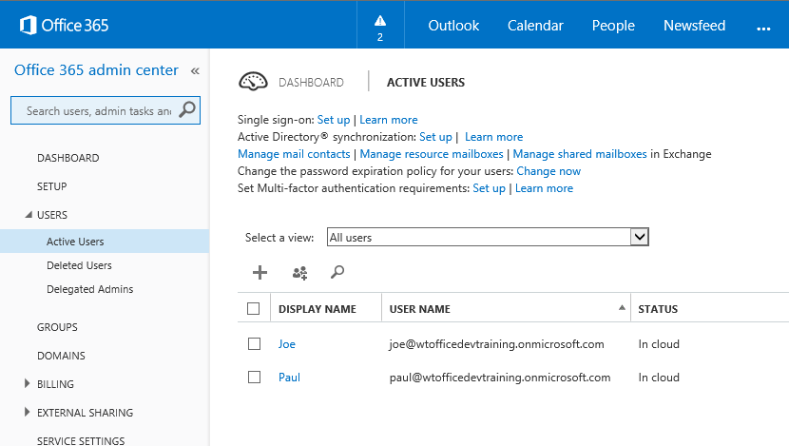
Azure Active Directory (Azure AD)
Included in Office 365 Subscription
Users & Groups managed in Office 365 Portal
Changes persisted in Azure AD
Notes:
Although an Azure AD is included with Office 365, accessing it via the Azure Management Portal requires a “sign-up.” However, there are no charges from Azure for using AD. (Charges will occur if other services are used.)

Slide 8
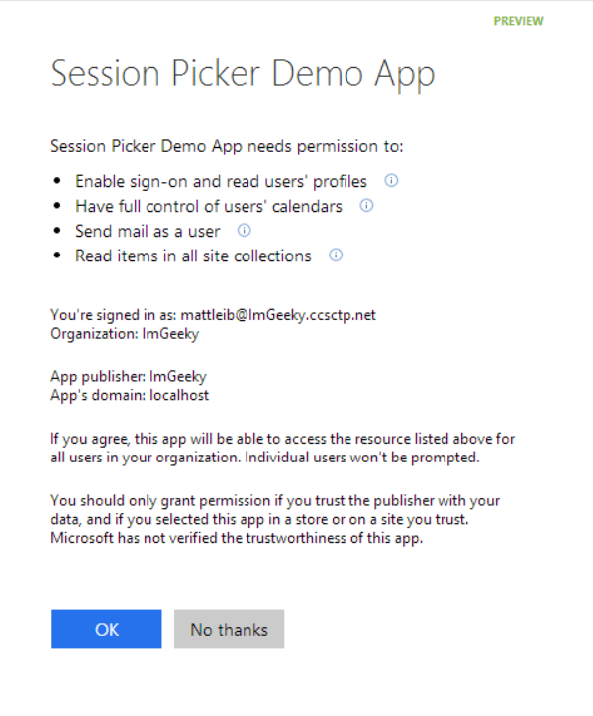
Azure AD OAuth in Office 365
Single auth flow for Office 365
Azure AD Graph, Exchange, SharePoint
Device apps and web sites
Admin and end-user consent
Secure protocol
OAuth 2.0
No capturing user credentials
Fine-grained access scopes
Supports MFA and federated user sign-in
Long-term access through refresh tokens
Notes:
With the Office 365 APIs, which leverage the Azure AD Oauth service, device apps no longer need to store user credentials.
Azure AD has implemented a “Common Consent” dialog, providing a consistent interface for permission grants.
Typically, OAuth is used to access a single resource. Common Consent is unique in that it can provide a token to Exchange Mail/Calendar/Contacts as well as SharePoint lists and files in OneDrive .

Slide 9
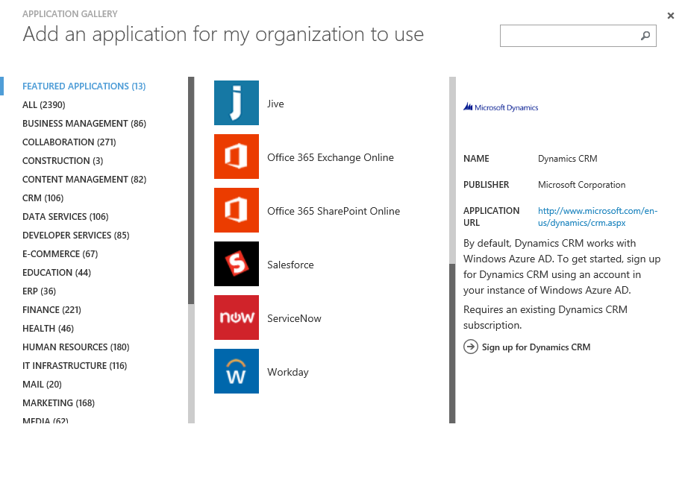
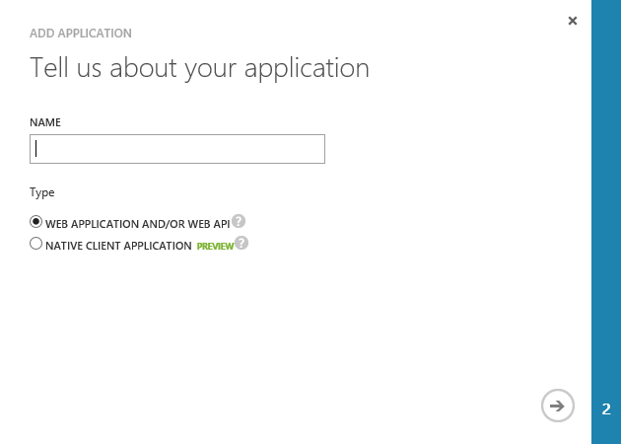
Application Registration
Application Types
Custom developed
Third-party, published in the gallery
Office 365 SharePoint, Exchange
Dynamics CRM
Thousands of others
Custom Applications
Web Application and/or WebAPI
Native Client

Slide 10
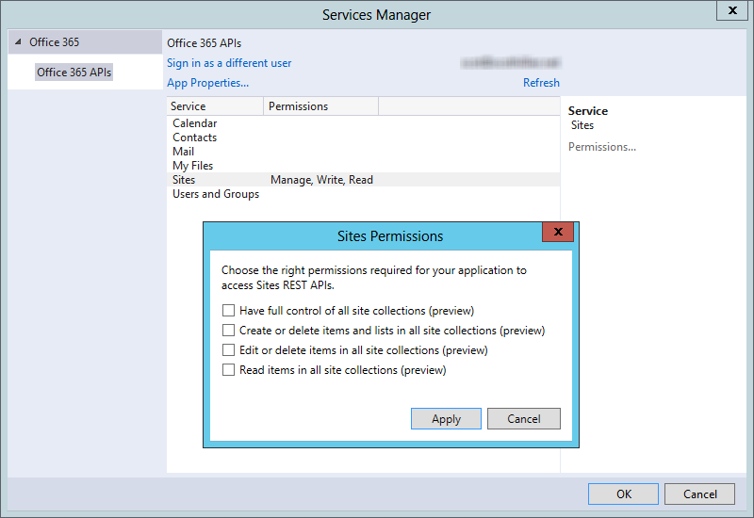
Connected Services in Visual Studio

Slide 11
Exercise 2, Tasks 1 - 4

Slide 12
Discovery Service

Slide 13
O365 Discovery Service
Returns a collection of endpoints specific to current user
Intended as the starting point for application
1. Sign-In
2. Get authorized
3. Discover endpoints for resource
4. Get Token
5. Access resource
API Libraries simplify necessary code

Slide 14
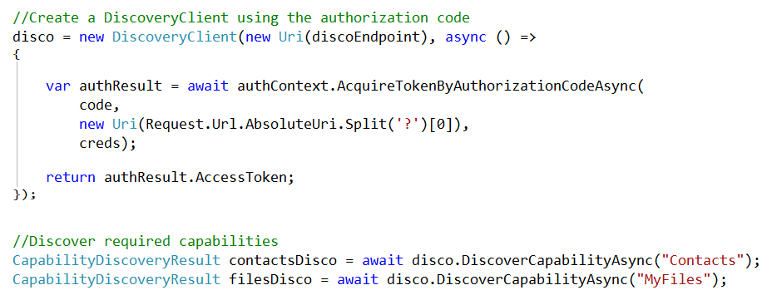
Coding the Discovery Service

Slide 15
Exercise 2, Task 5

